Slide 1
SIGNATURE COURSE STORIES
REVAMPING THE CORE CURRICULUM CHAPTER BY CHAPTER
PATRICIA MORAN MICKS, M.ED.
ASSISTANT DEAN
LORI HOLLERAN STEIKER, PH.D., ACSW
PROFESSOR & ASSOCIATE DEAN
THE UNIVERSITY OF TEXAS AT AUSTIN

Slide 2
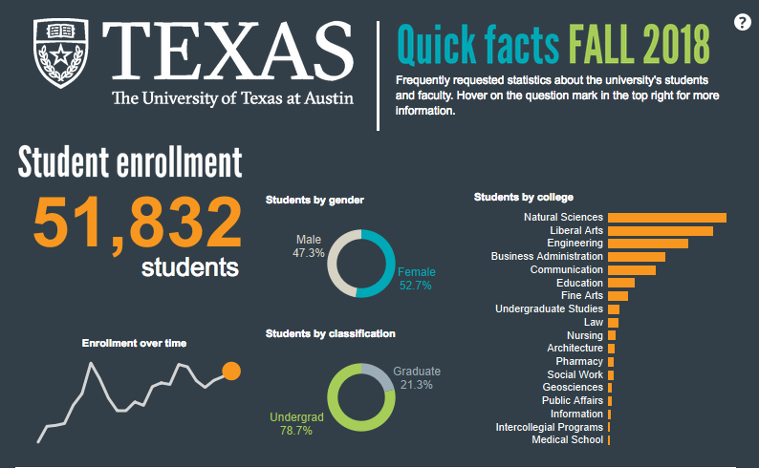
UT Austin Student Demographics

Slide 3
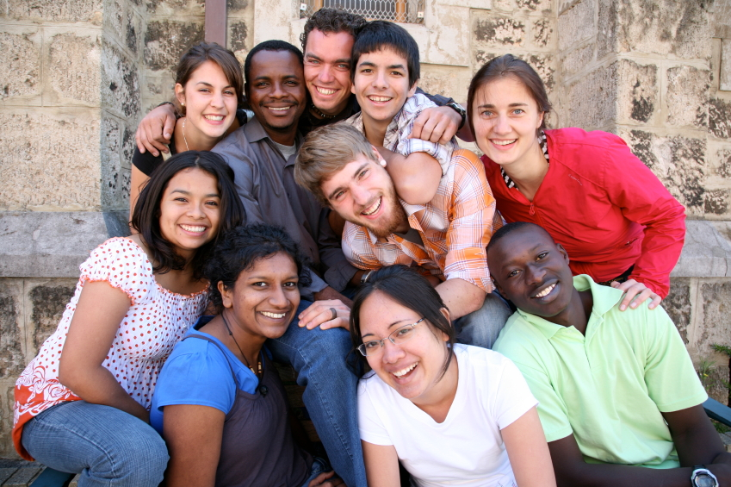
First-Year Experience Scope & Scale
Addressing Entering Students’ Strengths and Challenges:
First-year Interest Groups (FIGs)
  315 FIGs; 5,700 students; 315 Peer mentors
360 Connections
  8,626 students (98%) in a connection (FTIC)
Transfer-Year Experience (TYE)
  30+ TRIGs; 500 seats in transfer-only sig courses
University Lecture Series
  3,000-4,000 in attendance

Slide 4
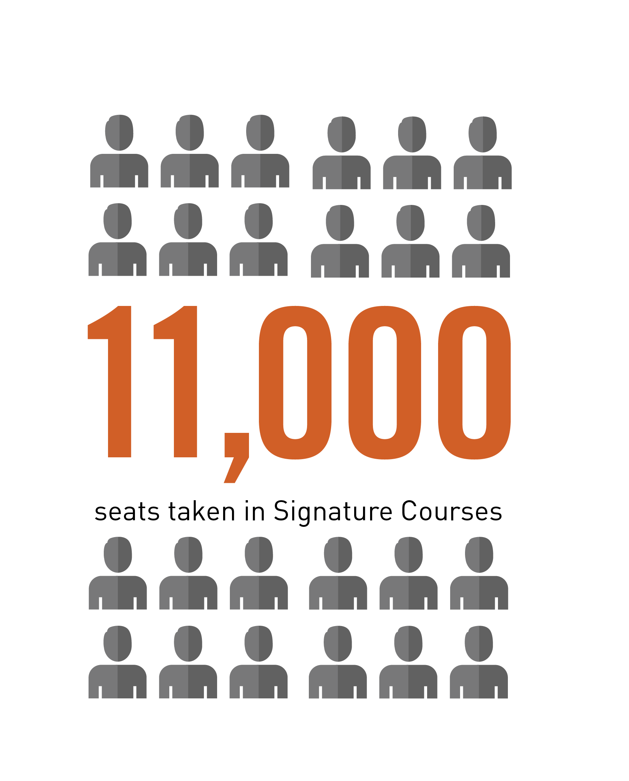
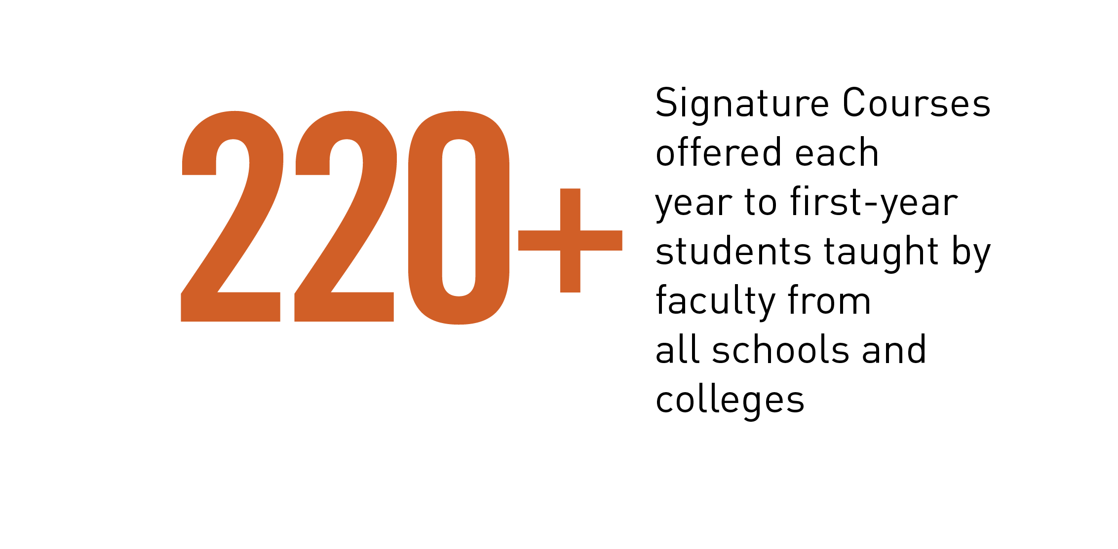
First-Year Experience Scope & Scale
Addressing Entering Students’ Strengths and Challenges:
Signature Courses
200
Graduate
Teaching Assistants
30 Undergraduate Assistants
Fall 2009 – Spring 2019
Total Students Enrolled in Signature Courses: 99,145
Total Number of Unique Signature Course Titles: 1,885
Total Number of Repeating Signature Course Titles: 580

Slide 5
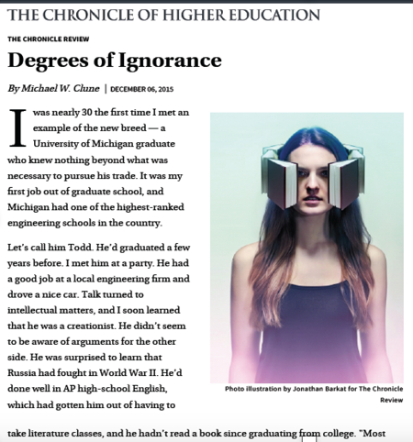
THE ISSUE
“An example of the new breed…A University of Michigan graduate….He had a good job at a local engineering firm and drove a nice car”
“He was surprised to learn Russia had fought in World War II”
“He’d done well in AP high-school English, which had gotten him out of having to take literature classes, and he hadn’t read a book since graduating high school”

Slide 6
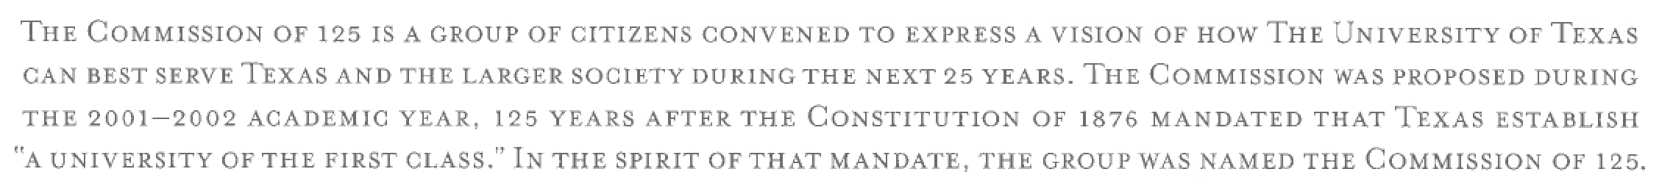
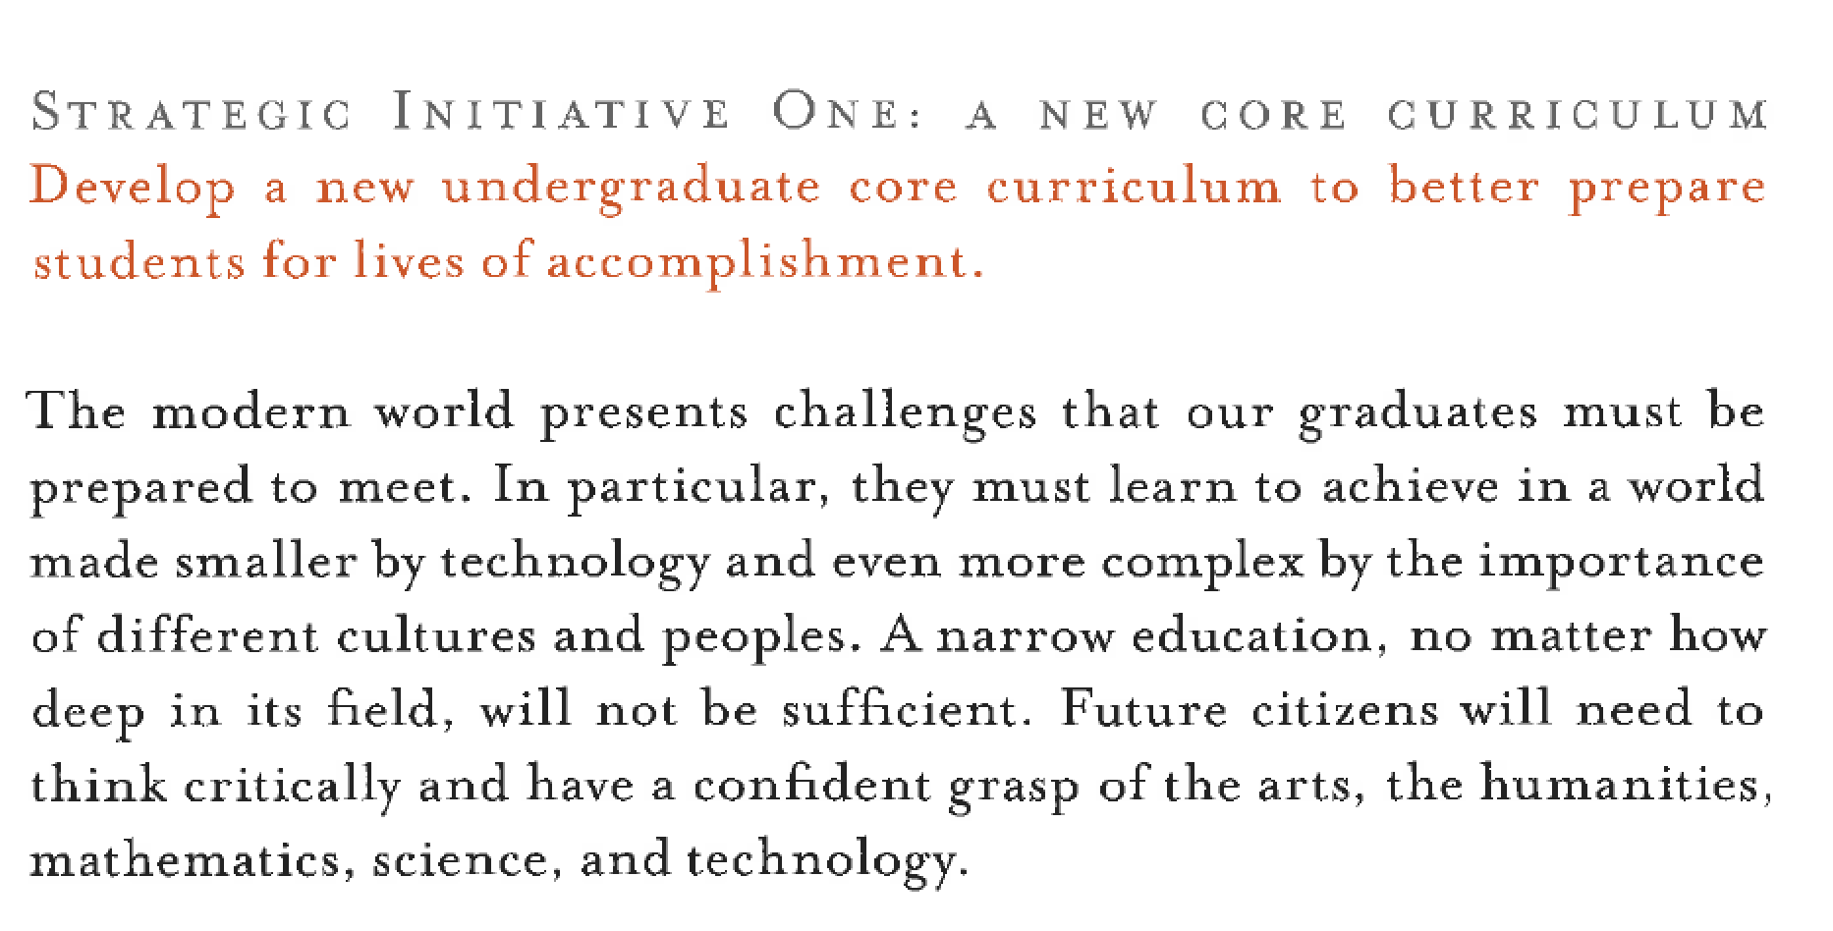
COMMISSION OF 125 – UT AUSTIN (2002)

Slide 7
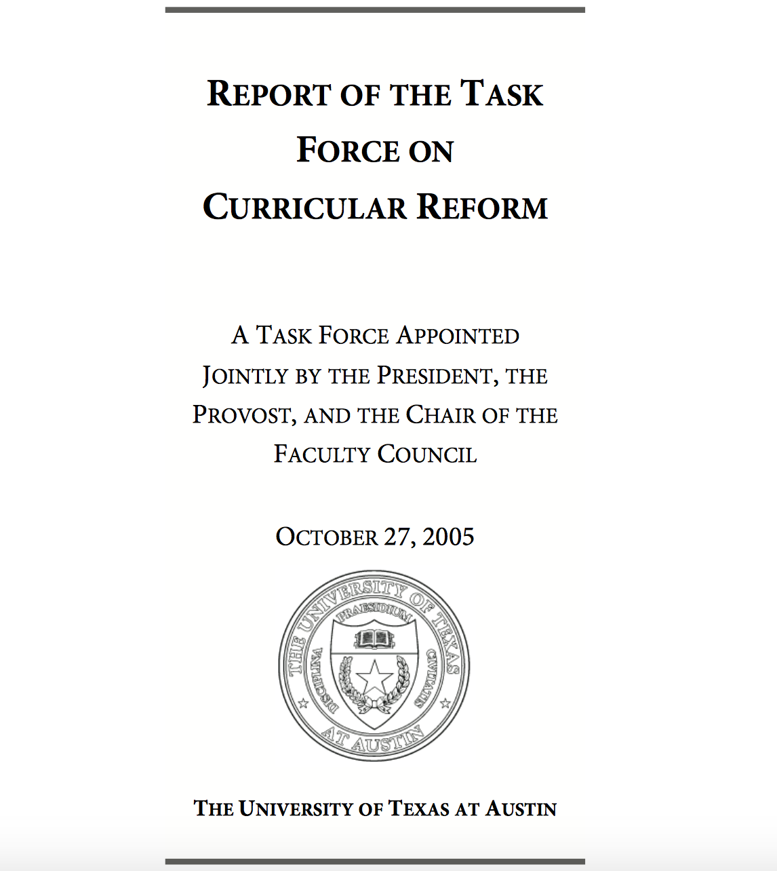
TASK FORCE ON CURRICULAR REFORM – UT AUSTIN (2005)
Creation of a new structure, the School of Undergraduate Studies (UGS), led by a new academic dean to support academic change and oversee the Core Curriculum
Creation of a more supportive home for new students without majors
Creation of Signature Courses
Creation of the Flag program for a reimagined Core Curriculum

Slide 8
SIGNATURE COURSES
The Signature Courses at the University of Texas at Austin will connect students with distinguished faculty members in unique learning environments. By way of this rigorous intellectual experience, students will develop college-level skills in research, writing, speaking, and discussion through an approach that is interdisciplinary, collaborative, experiential, and contemporary.

Slide 9
FIRST-YEAR STUDENTS IN TRANSITION: LEARNING HOW TO LEARN
Linear thinkers
Every problem has a solution
Taught to the test
Teacher is authority
Fixed mindset
Texas - Top 6%
High School Learners
Non-linear assignments
Many problems do not have a single solution
No set curriculum across the board
Many authorities/challenge authority
Growth mindset
Learn from failure
College Scholars

Slide 10
Signature Course Essential Elements
Element | Description/Goal
Distinguished Faculty | Renowned teachers, scholars, researchers
Interdisciplinary & Contemporary Content | Faculty member’s choice
Critical Thinking | Solving problems, Forming Arguments, Applying Concepts
Writing | Intro to college-level writing and thinking
Oral Communication | Effectively communicating thoughts and ideas
Information Literacy | Discerning reliability
Campus Gems | Libraries, Collections, Performances, Laboratories
University Lecture Series | “Concert-sized,” shared, academic lectures

Slide 11
Signature Courses
How and why do Signature Courses work?
  UT’s most distinguished faculty are encouraged to teach the subject content about which they are most passionate
  Departments are compensated financially in
  proportion to participation
  The School of Undergraduate Studies oversees this
  and other campus-wide academic programs
  Transformation of campus culture surrounding
  first-year academic expectations and learning

Slide 12
Signature Courses
How do we measure critical thinking skills? How do students engage in intellectual discussions?
of students agreed/
strongly agreed that
the SC instructor
made them feel free
to ask questions
of students agreed/
strongly agreed that other students respect their point of view during class discussion
92%
88%
of students agreed/
strongly agreed that listening to other students’ ideas is a valuable learning experience
of students indicated that they reconsidered or changed their opinion based on the input of others
90%
57%
Mid-Semester Survey results (2018-19)

Slide 13
Signature Courses
How do we measure critical thinking skills? Can students synthesize course content and relate it to strategies of inquiry in other disciplines?
of students report their instructor is challenging them to examine ideas or concepts from different perspectives
of students report that their instructor is helping them draw connections between different fields of study
91%
84%
Mid-Semester Survey results (2018-19)

Slide 14
Student Collaboration Survey Findings
“I got to hear different viewpoints since perspective and personal experiences often affected ideas. It has helped me be more open-minded and conscientious.”
“I learned how to consider other points of view and understand how people with different backgrounds perceive things in different ways.”
“Because my peers interpret the same class information differently than I do, their unique understandings of class content opened new avenues of personal learning for me in the class, exposing me to new ideas and interpretations of what we talked about in lectures.”
“I would like to continue to learn how to solve problems that don’t have a definite answer.”
Core Curriculum Assessment of SC – Fall 2018

Slide 15




FUTURE INNOVATION IN SIGNATURE COURSES
#UTSHIFT
Through the cutting-edge collaboration of scholars, researchers and instructors with college health and student-affairs a national model for proactive prevention of substance misuse.
$$+$$

Slide 16
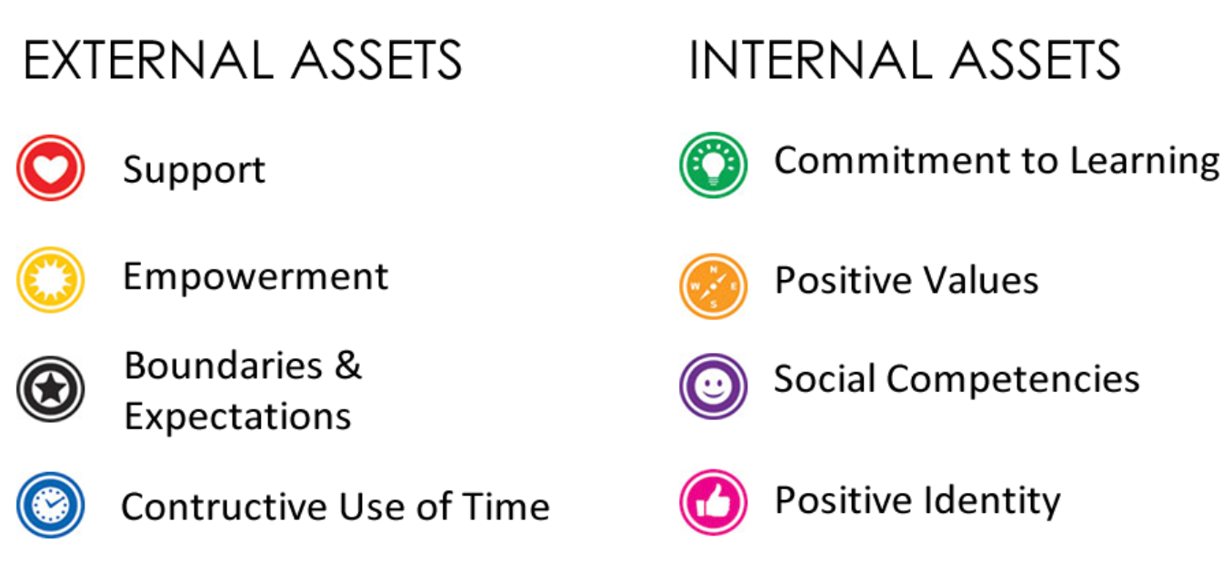
Search Institute’s 40 Assets (for 40 Acres)
FUTURE INNOVATION IN SIGNATURE COURSES

Slide 17
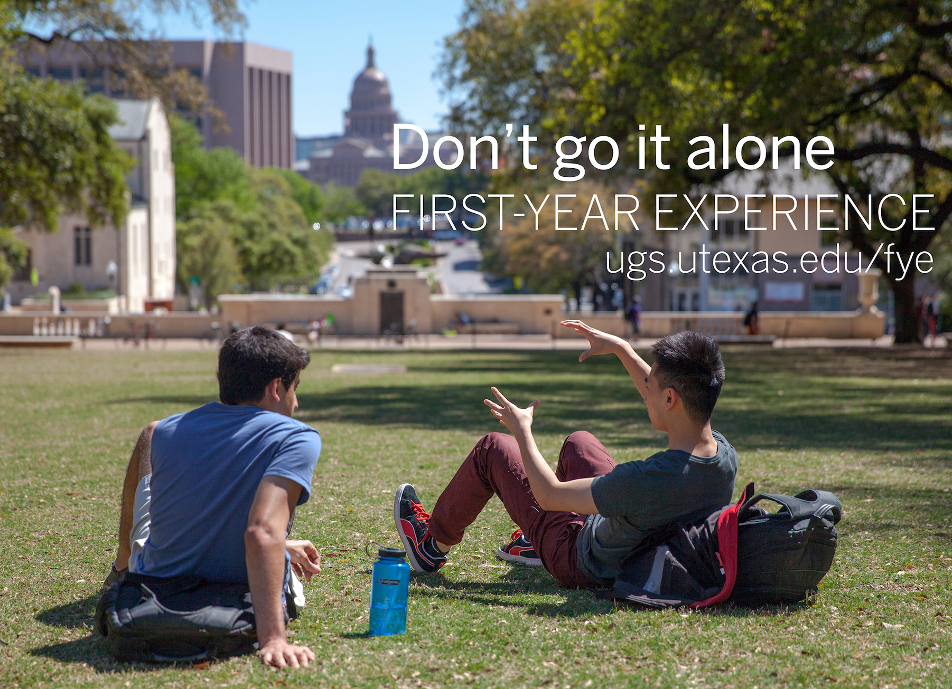
THANK YOU!
Please Contact Us For More Information!
patty@austin.utexas.edu
lorikay@mail.utexas.edu
Please complete an evaluation through Guidebook!

